Slide 1




Review 1 CLOUD COMPUTING ( J^{th} Component )
Group Members
Shreya (22MCA0230)
Tanya Kumari (22MCA0065)
Mohit kumar (22MCA0170)

Slide 2
CONTENTS
Domain And Title
Abstract
Introduction
Literature survey
Architecture
Modules And Methods

Slide 3
Domain Cloud + Web development Title MCA Hotspot

Slide 4
ABSTRACT
Digitization has successfully altered the educational process in a impressive manner. One of the newer tool in recent techniques utilised in learning is blogging.
Today, blogging is a crucial tool for staying current with fashion and getting the most recent information on a specific subject. It could also be seen as professional counsel or a suggestion for a certain subject.
A favourable environment for many literacy processes, such as critical thinking, reflection, questioning, modelling, social practises, discussion, and development, is provided by blogging.
We are going to built one such platform for the students of MCA for better interaction, ideas sharing , remain up to date, latest trends and many more exciting stuffs.

Slide 5
INTRODUCTION
An online blogging application called "MCA HOTSPOT" allows users to post blogs and receive comments and responses from students in the field of MCA courses and others too.
Each blog will have a view counter that counts how frequently the post has been seen .
It has been installed on a server, from which users from all over the world can access blogs and respond to them with comments or replies.
The blog website's home page will feature the most popular post.
Although there are numerous blogging websites on the internet, none of them can be used solely for MCA content. As a result, I created a program that will only cover MCA-related subjects.

Slide 6
LITERATURE SURVEY
S. No | Title of the paper | Discussion
(1) | A Review of top blogging Platforms. -Phyo Min Tun ( University of Greenwich) | This article reviews top blogging platforms and finds that design, customization, social media sharing, ease of use, community, cost, installation, functionality, features, e-commerce, languages, publishing method and support are all positively related to usage.
(2) | The Effectiveness of Using Online Blogging for Students’ Individual and Group Writing. -Hashem Alsamadani (Umm Al-Qura University) | Blogging has revolutionized EFL pedagogy and methodology, allowing learners to improve their writing skills in terms of content, word choice, style, language mechanics and more. This study recommends that blogging be part of writing classes and incorporated into school curricula.
(3) | Blogging to Enhance Writing Skills: A Survey of Students’ Perception and Attitude. - Melor Md. Yunus (Universiti Kebangsaan Malaysia) | The use of a blog can positively enhance learning in the second language classroom and improve writing skills, with positive uses such as writing for an audience and peer review, analytical skills, and a sense of community.

Slide 7
LITERATURE SURVEY (continued…)
Ref No | Title of the paper | Discussion
(4) | An Overview of Cloud Based Content Delivery Networks: Research Dimensions and State-of-the-Art -Research School of Computer Science, ANU, Canberra, Australia, 2018 | This paper discusses the Cloud-based CDNs provide an elastic platform with ability to dynamically and easily scale capacity up and down and hide the complexity of CDN applications and content.
(5) | Extracting Representative Information on Intra-Organizational Blogging Platforms - Xunhua Guo, Qiang Wei, Guoqing Chen, Jin Zhang and Dandan Qiao{University of Minnesota) | This paper proposes a system framework for extracting representative information from intra-organizational blogging platforms, using the REPSET (REPresentative SET) method. Results from data experiments and user evaluations demonstrate that REPSET and the extraction system can provide outstanding performance, in comparison to benchmark methods.

Slide 8
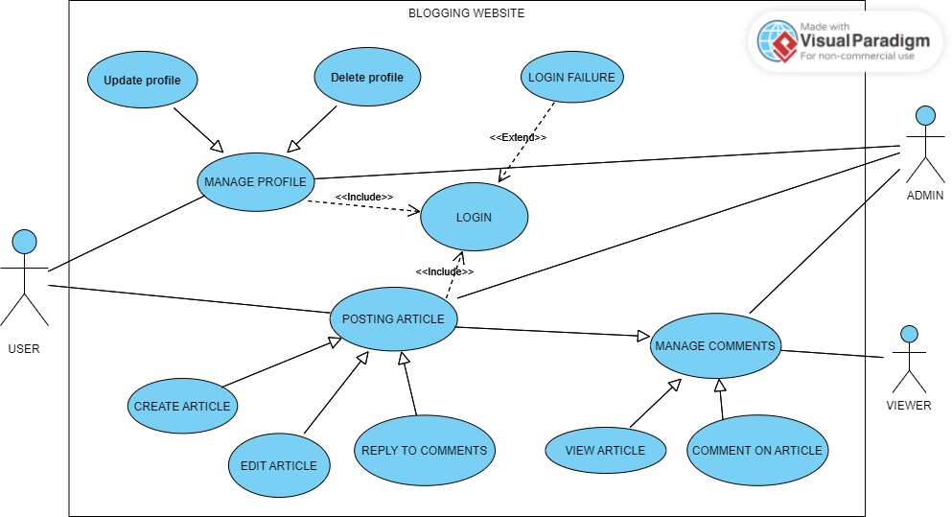
ARCHITECTURE

Slide 9
MODULES AND METHODS
Authentication – verify with email ID
Create Blog – Manage posts
Read More – Minimize and Maximize posts
Add Comments – Views can add comments
Post views count – Like Instagram
Deployment – Probably AWS
Database – Probably Firebase

Slide 10


